Slide 1
A Metric for Hand Comfort/Discomfort Evaluation Towards Expressivity in Spatial Control
Bachelor Thesis Presentation
Student: Jonas Mayer
Supervisor: Nicholas Katzakis
Director: Gudrun Klinker
Garching, July 13th 2016

Slide 2
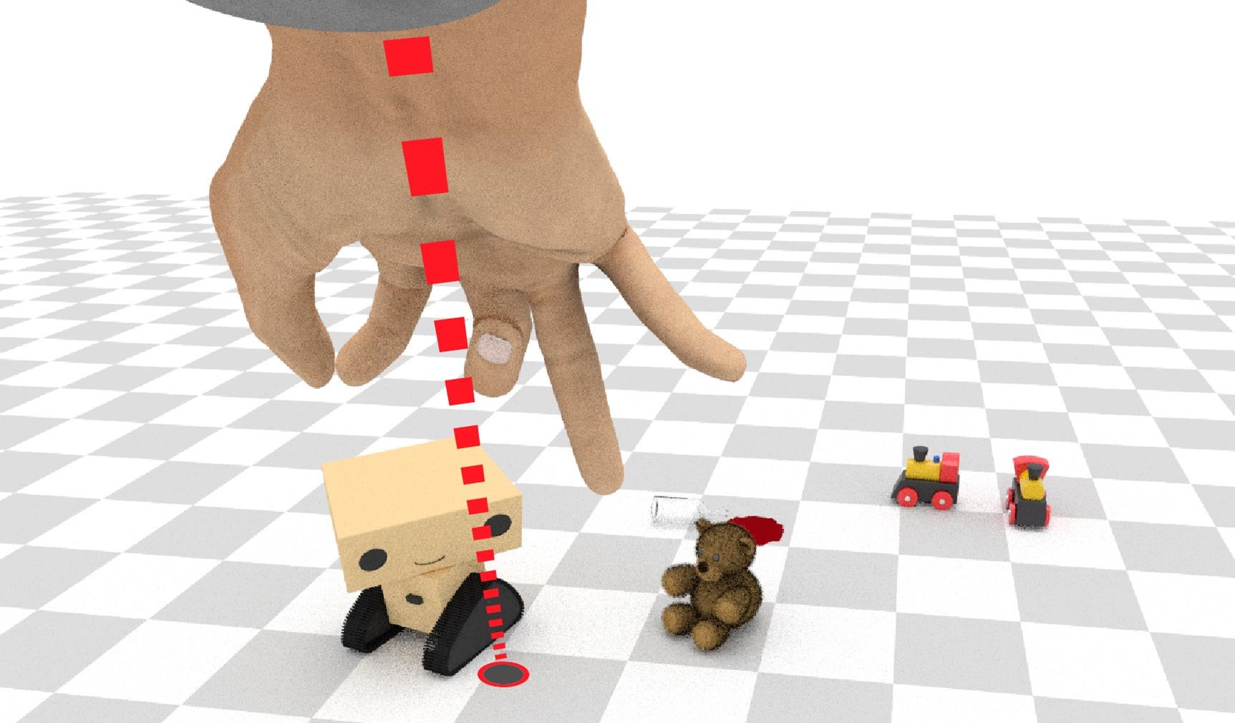
Motivation: Controlling a Robot
Traditional input methods and speech not optimal
Use gestures and postures
Designer challenge: which hand postures are the best for
Performance?
User Experience?

Slide 3
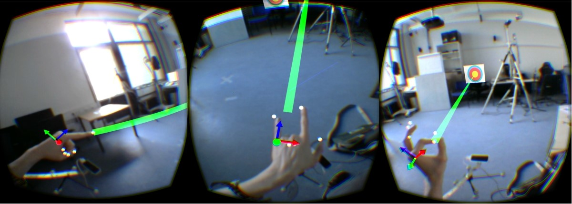
Related Work: Nicholas Schneider (TUM)
Compare three different hand postures
Point
Spiderman
Pinch
in a target shooting test regarding performance and user experience.
Results:
Pointing posture generally best

Slide 4
Study Goal
Problem
Hand posture evaluation either subjective or work intensive
Hypothesis
Hand posture comfort and discomfort affect performance and obviously user experience.
Goals
Create a metric for quick and objective hand posture comfort/discomfort evaluation
Show its effect on performance in a pointing task

Slide 5
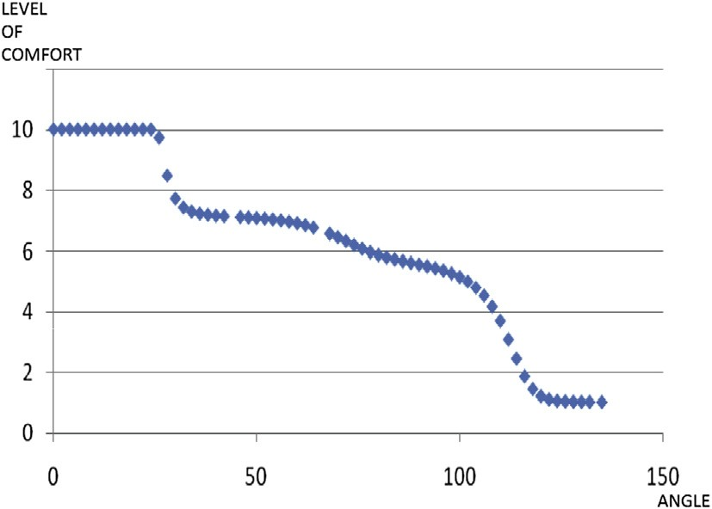
Related Work
Apostolico et al:
Introduce and determine the Range of Rest Posture for human joints (later more)
Naddeo et al:
Propose a quantitative method for postural comfort evaluation
Comfort based on the distance to the range of rest posture
Short et al:
Comfortable postures generally generate higher accuracy

Slide 6
Related Work: Comfort and Discomfort (Vink et al.)
Comfort
“pleasant state or relaxed feeling of a human being”
Influenced by subjective impressions and expectations
Discomfort
“an unpleasant state of the human body”
Caused by physical stress

Slide 7
Hand Comfort/Discomfort Components
Four components affect hand comfort/discomfort:
Deviation from Range of Rest Posture (RRP)
Inter Finger Angles (IFA)
Finger Hyperextension (HE)
Finger Abduction (FA)

Slide 8
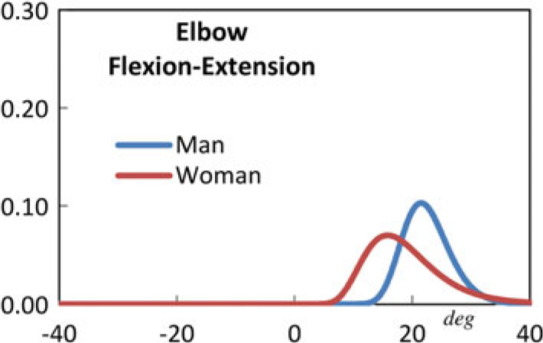
Hand Comfort/Discomfort Components
Deviation from Range of Rest Posture (RRP)
Apostolico et al:
Every joint has a rest posture
When in the rest posture, maximum comfort is perceived
Deviation from rest posture should decrease comfort
Due to anatomical differences: look at Range of Rest Posture
In our case: look at the RRPs for all hand joints

Slide 9
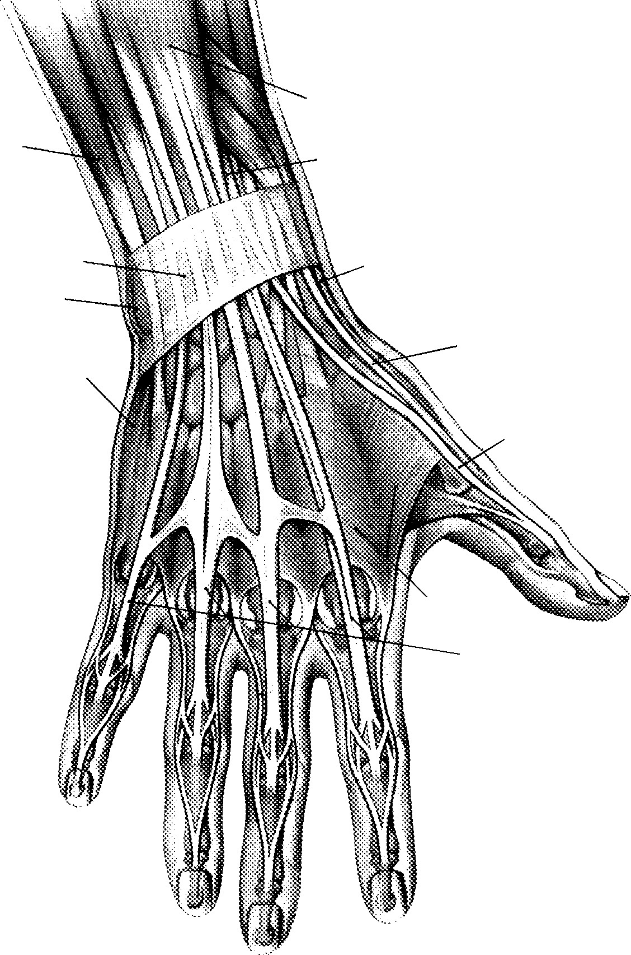
Hand Comfort/Discomfort Components
Inter Finger Angles (IFA)
Complex Hand Anatomy:
Finger extendors and flexors share same muscles
Inter-finger tendons
Individual finger movement limited
High inter finger angle differences create stress on tendons, muscles
Discomfort

Slide 10
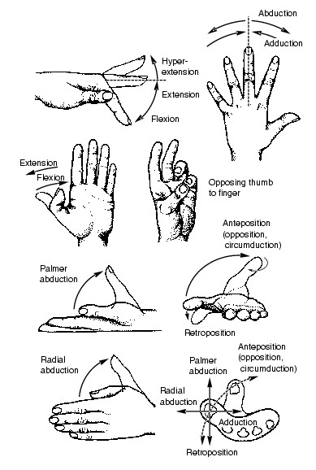
Hand Comfort/Discomfort Components
Finger Hyperextension (HE)
LaViola et al. : “[hyperextension] puts more strain on the [MCP] joints and tendons than the hand is accustomed to”
High stress on joints, tendons, muscles
Discomfort

Slide 11
Hand Comfort/Discomfort Components
Finger Abduction (FA)
Analog to hyperextension:
High abduction creates stress on joints, tendons, muscles, soft tissue
Discomfort

Slide 12
Concrete Implementation: RRP Metric Comp.
Hand Model:
21 DOF Angle Based Hand
Interpret Hand as a vector of length 21
In Theory:
There is a RRP for each DOF
Identify RRP for each DOF
For a particular hand posture, add up the distances to the RPP for each joint
1
1
1
1
1
1
1
1
1
2
2
2
2
1
3

Slide 13
Concrete Implementation: RRP Metric Comp.
For simplicity:
Define RRP for whole hand as a set of 50 relaxed hand postures
Calculate minimum Euclidian distance to RRP set for particular hand
Yields RRP component for whole hand
Metric value 0: maximum comfort
Perceived comfort decreases when metric value increases

Slide 14
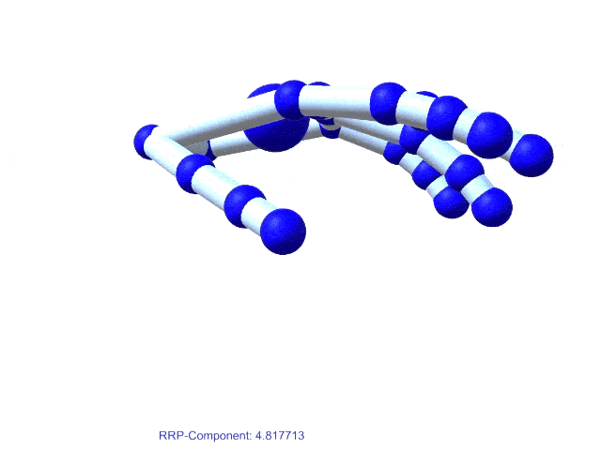
Concrete Implementation: RRP Metric Comp.

Slide 15
Naïve & Improved Metric
Naïve Metric
Add up metric components for whole hand
Weight components with estimated importance coefficients
Resulting metric:
Metric value = 0 → maximum comfort, minimum discomfort
Metric increases → comfort decreases, discomfort increases

Slide 16
Naïve & Improved Metric
Improved Metric
Naïve Metric ignores anatomical differences of fingers
Compute the metric components for each finger, weight components differently
Problem: 17 coefficients hard to estimate
Collect data in user study
Use machine learning to find optimal coefficients

Slide 17
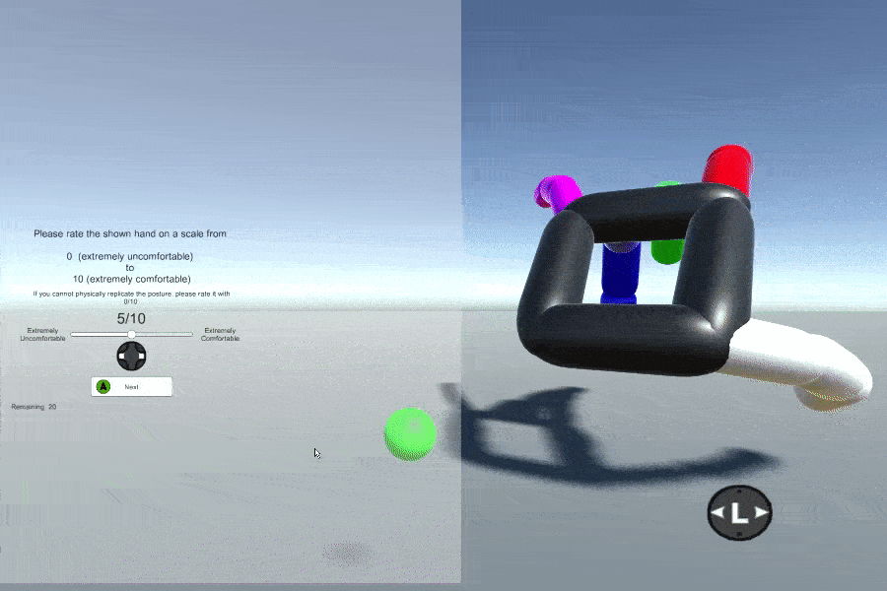
User Study
Task 1: Hand Posture Rating
Show subject randomly generated hand posture
Subject has to mimic hand posture
Subject has to rate hand posture on a intuitive comfort/discomfort scale from 0 to 10
Beforehand: show relaxed and extremely uncomfortable hand posture for reference

Slide 18
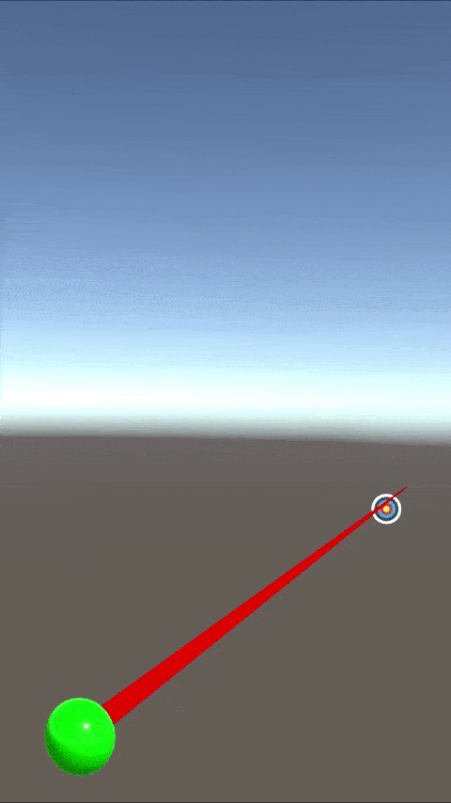
User Study
Task 2: Target Shooting
Again show subject randomly generated hand posture
Again mimic and rate
Subject has to perform target shooting test using that posture
Detect palm pose with ART
Track hand posture with Leap

Slide 19
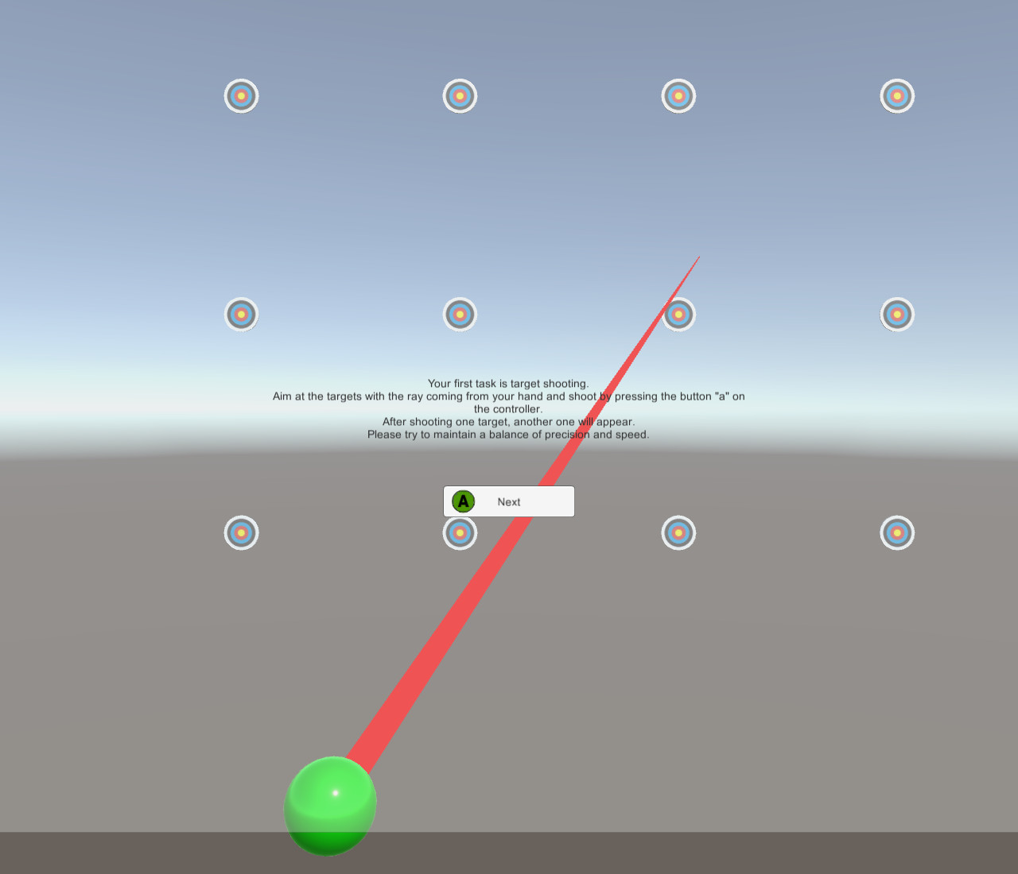
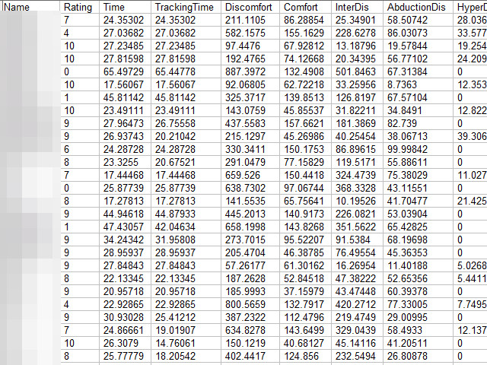
User Study
Task 2 (contd.)
Total of 12 randomly sorted targets
Measure for performance: total task completion time
Logged Parameters:
User Rating
Comfort/Discomfort Components
Total Task Time
Complete hand

Slide 20
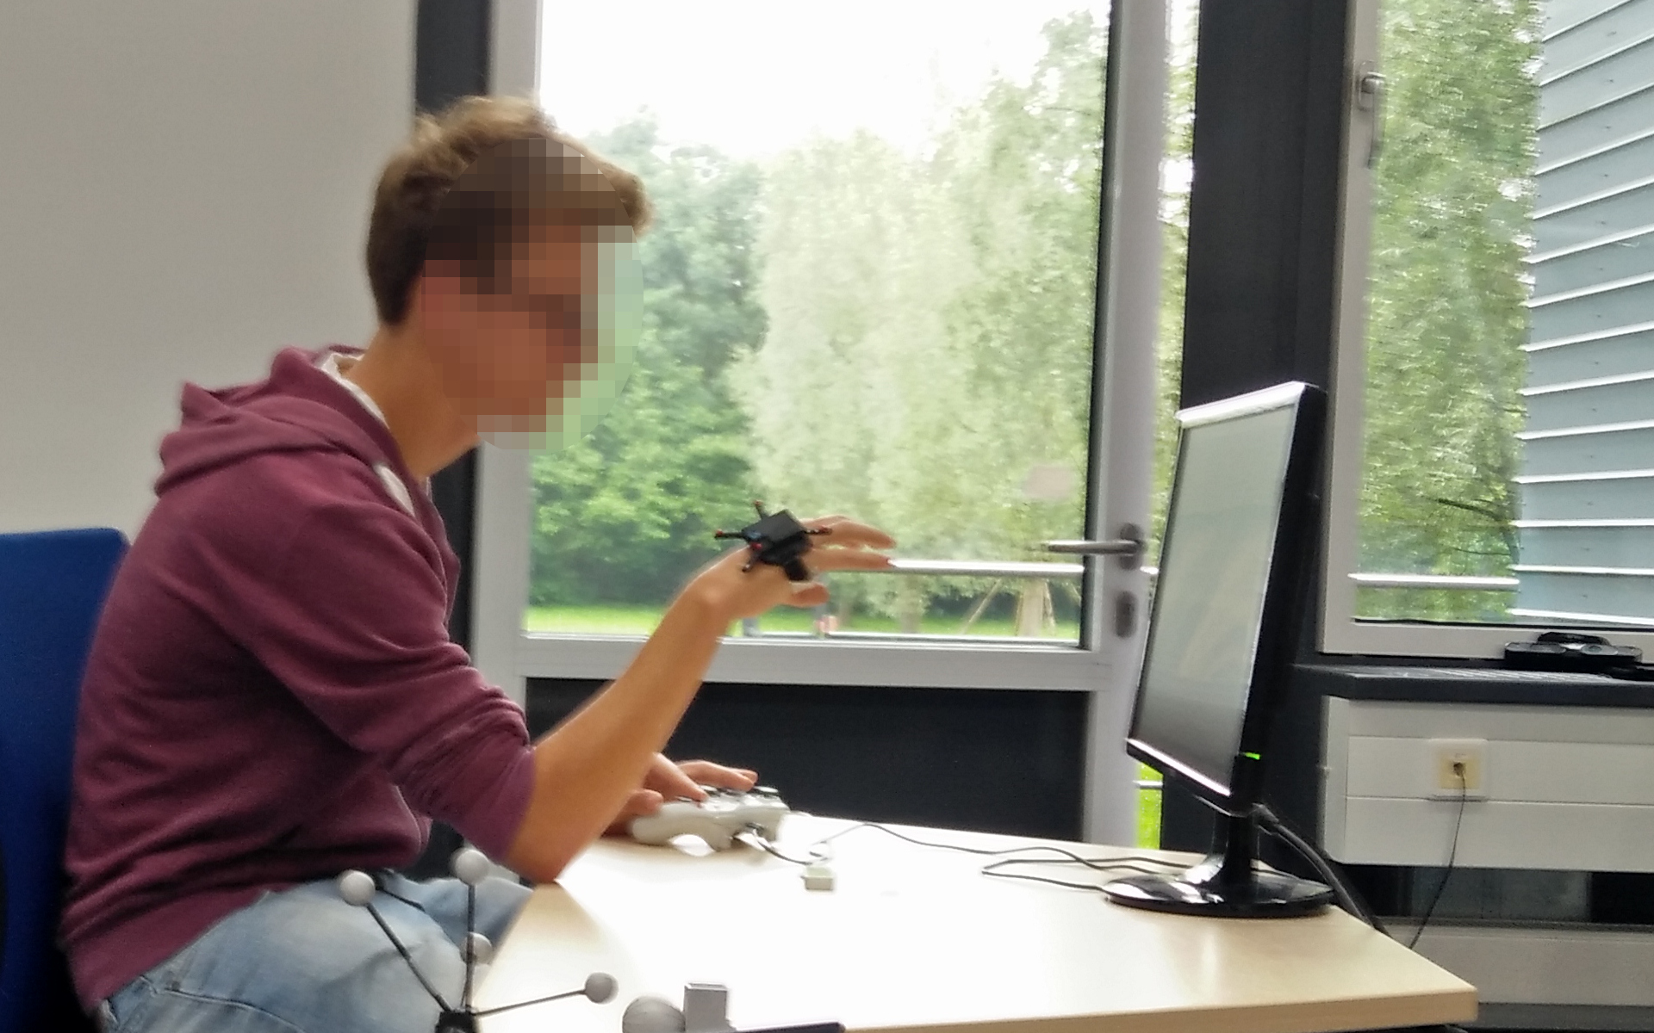
User Study
Total of two user studies
Total of 21 participants
310 data sets from User Rating
250 for training the metric
60 for testing the metric
35 data sets from Target Shooting

Slide 21
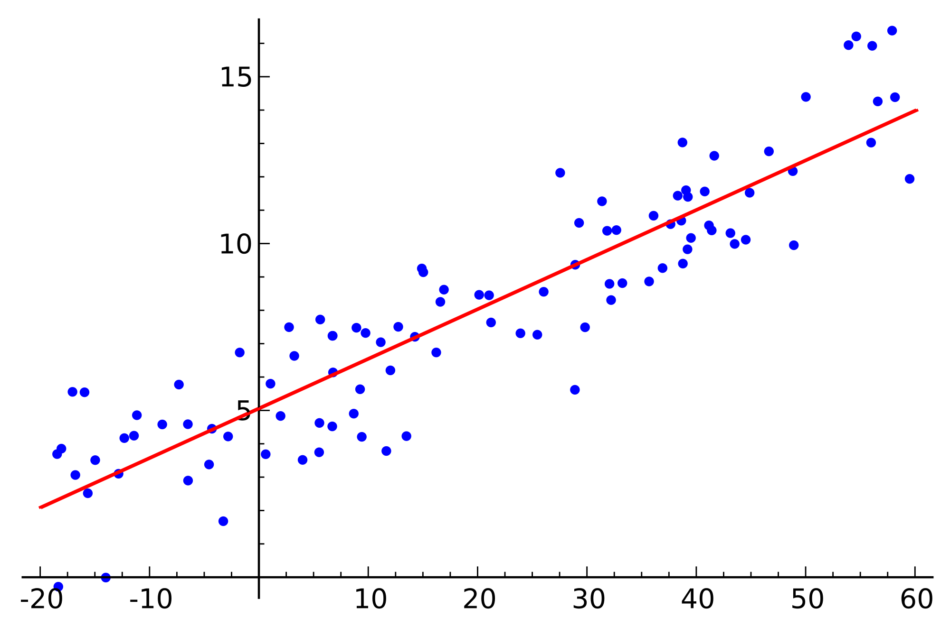
Improving the Metric
Problem: finding 17 coefficients, to fit the metric to the user ratings
Similar to a line fitting problem:
We want to find parameters to minimize the error between our metric and the user rating
Use least squares algorithm to find optimal coefficients from the 250 datasets

Slide 22
Results: Improved Metric in User Rating
Pearson Correlation: -0.748993, p-value: 5.89e-12

Slide 23
Results: Improved Metric in Target Shooting
Pearson Correlation: -0.6651999, p-value: 6.73e-9

Slide 24
Discussion
Testing the improved metric against test data
Shows reasonable correlation
Improved metric is good extrapolation of training data
The created metric reflects perceived comfort/discomfort
Target shooting test
Hand posture comfort does influence performance
Strengthens Short et al. (comfort → accuracy)
But: small dimensions of study limit expressiveness

Slide 25
Conclusion
1. Creating a Comfort/Discomfort Metric
Goal: Metric for quick, objective hand posture evaluation
Creation based on
Comfort/Discomfort Models
Hand Anatomy and Ergonomics
Tweaked the metric using data from a user study
Verified the metric in a testing user study

Slide 26
Conclusion
2. Showing Importance of Metric
Goal: Show Comfort/Discomfort-Performance Correlation
Tested in Target Shooting Task
Test Results indicate that hand posture comfort/discomfort do affect performance

Slide 27
Future Work
1. Long Term Effects of Comfort and Discomfort
Our study neglects long term effects
Strong discomfort symptoms are known to occur after long periods of time
For other contexts long term effects might be relevant
2. Create Metrics for other Contexts
Automotive, Seats, Mattresses (Whole Body)
Shoes (Feet)

Slide 28
Acknowledgements
Nicholas Schneider
Dr. Frieder Pankratz

Slide 29
Questions?

Slide 30
Appendix

Slide 31
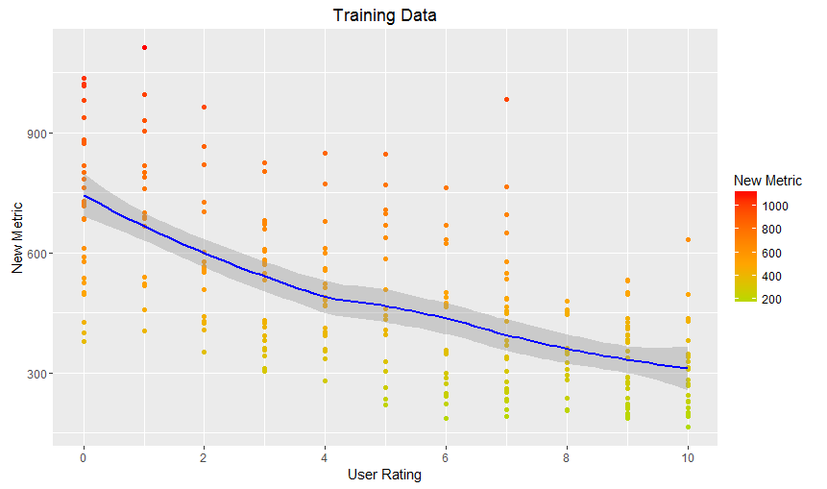
Results
Training Data: Improved Metric and User Rating
Pearson Correlation: -0.6453242
p-value: < 2.2e-16
Not perfect:
Anatomical and psychological differences
Short term effects only
Few discrete steps

Slide 32
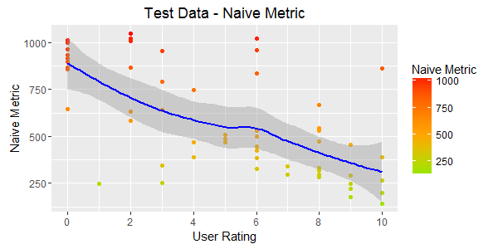
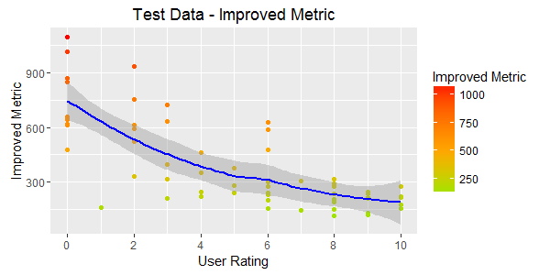
Results
Test Data: Naive Metric and User Rating
Pearson Correlation: -0.6651999
p-value: 6.73e-9
No big difference on first sight
However, standard error is smaller, better correlation

